Slide 1

Artificial Intelligence: Benefits, challenges and risks
Soumya Banerjee
University of Cambridge

Slide 2
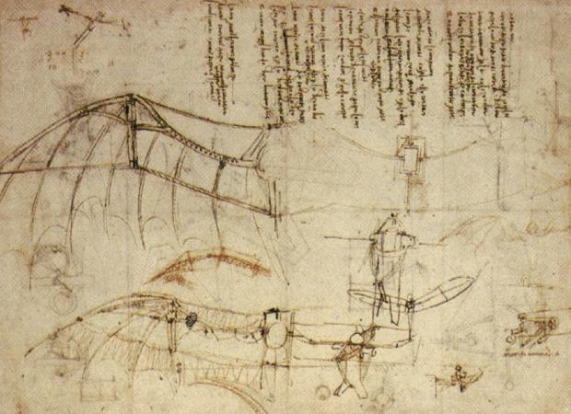
Mimicking nature

Slide 3
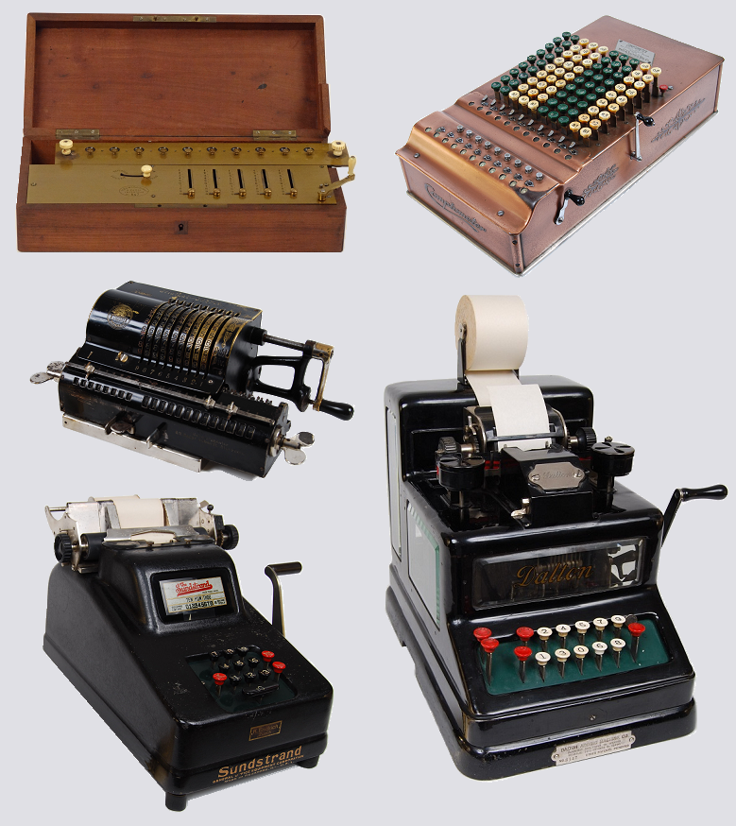
Computing machines

Slide 4

What is AI?
Can we mimic what is going on in our brains?

Slide 5
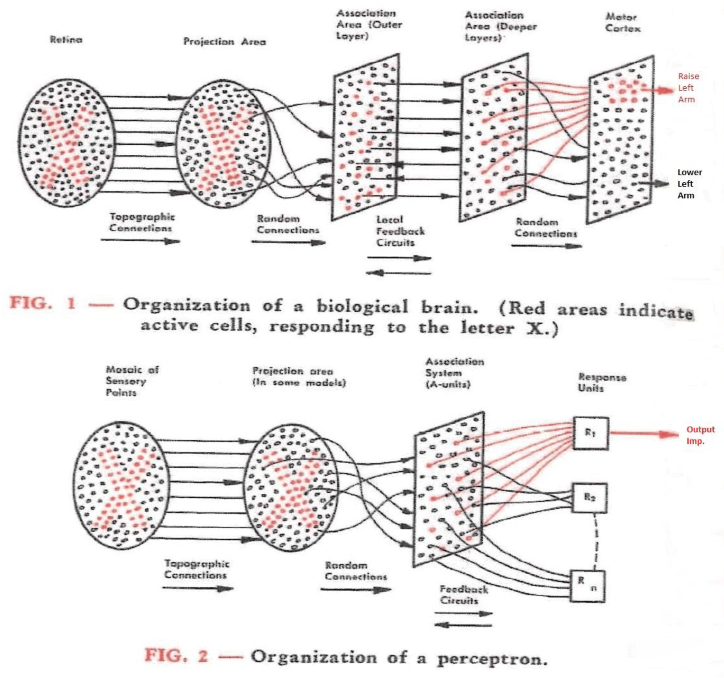
What is AI?
Baby steps
Perceptron

Slide 6
Can machines think?

Slide 7
Can machines think?
Can a submarine swim?

Slide 8
Can machines think?
Can a submarine swim?
“The question of whether a computer can think is no more interesting than the question of whether a submarine can swim” – Edsger Dijkstra

Slide 9
Current Trends and Applications
Deep learning
Generative AI
Applications in Healthcare, Finance, Autonomous Systems

Slide 10
Risks of AI
Ethical considerations
Bias
Data privacy
Impact on jobs
Systemic effects on our planet
Risk of anthropomorphizing

Slide 11
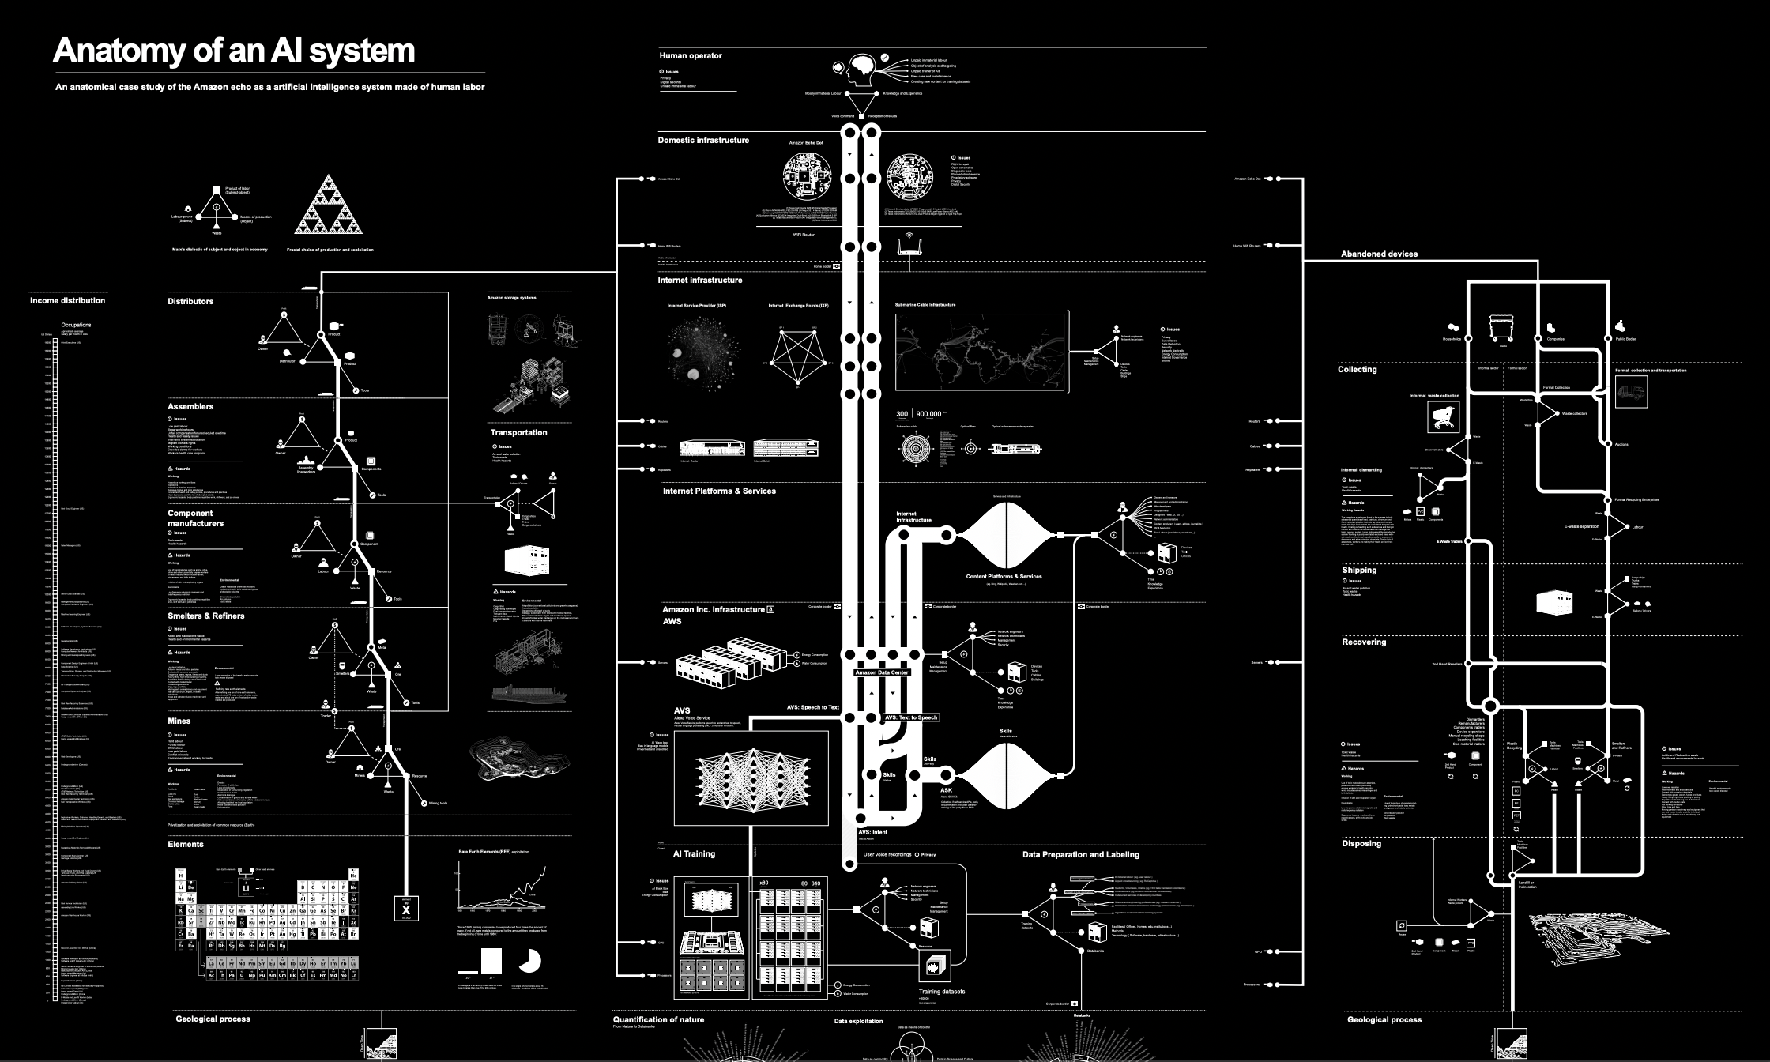
Other AI risks

Slide 12
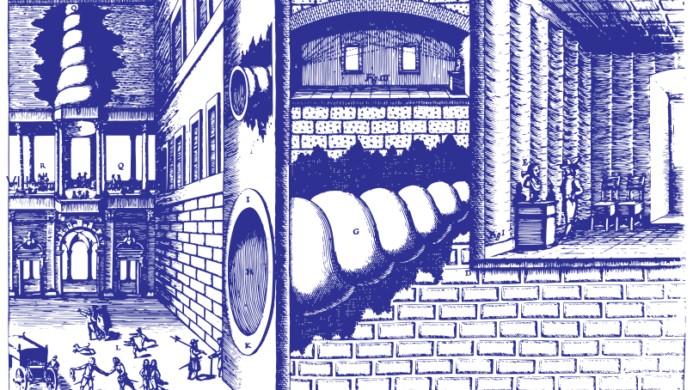
Other AI risks
Notes:
In 1673, the Jesuit polymath, Athanasius Kircher, invented the statua citofonica – the ‘talking statue.’ K

Slide 13
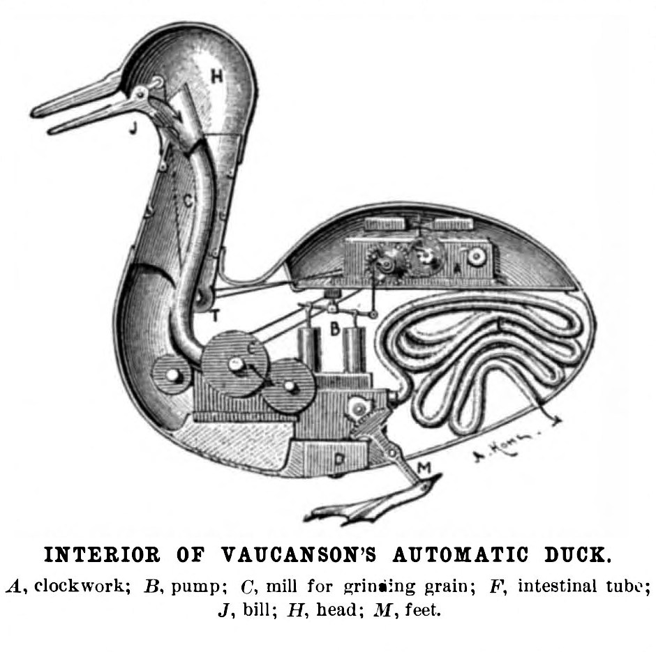
Notes:
Digesting Duck, was an automaton in the form of a duck, created by Jacques de Vaucanson and unveiled on 30 May 1764 chatGPT

Slide 14
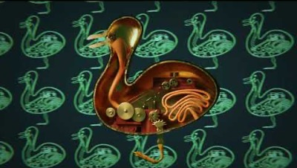

Slide 15
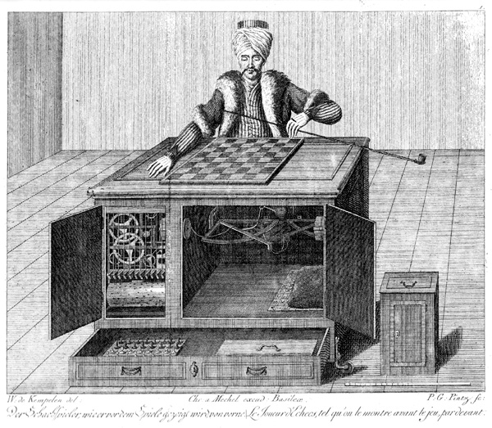
Notes:
Automaton Chess Player (German: Schachtürke, lit. 'chess Turk'; Hungarian: A Török), or simply The Turk, was a fraudulent chess-playing machine constructed in 1770, which appea

Slide 16
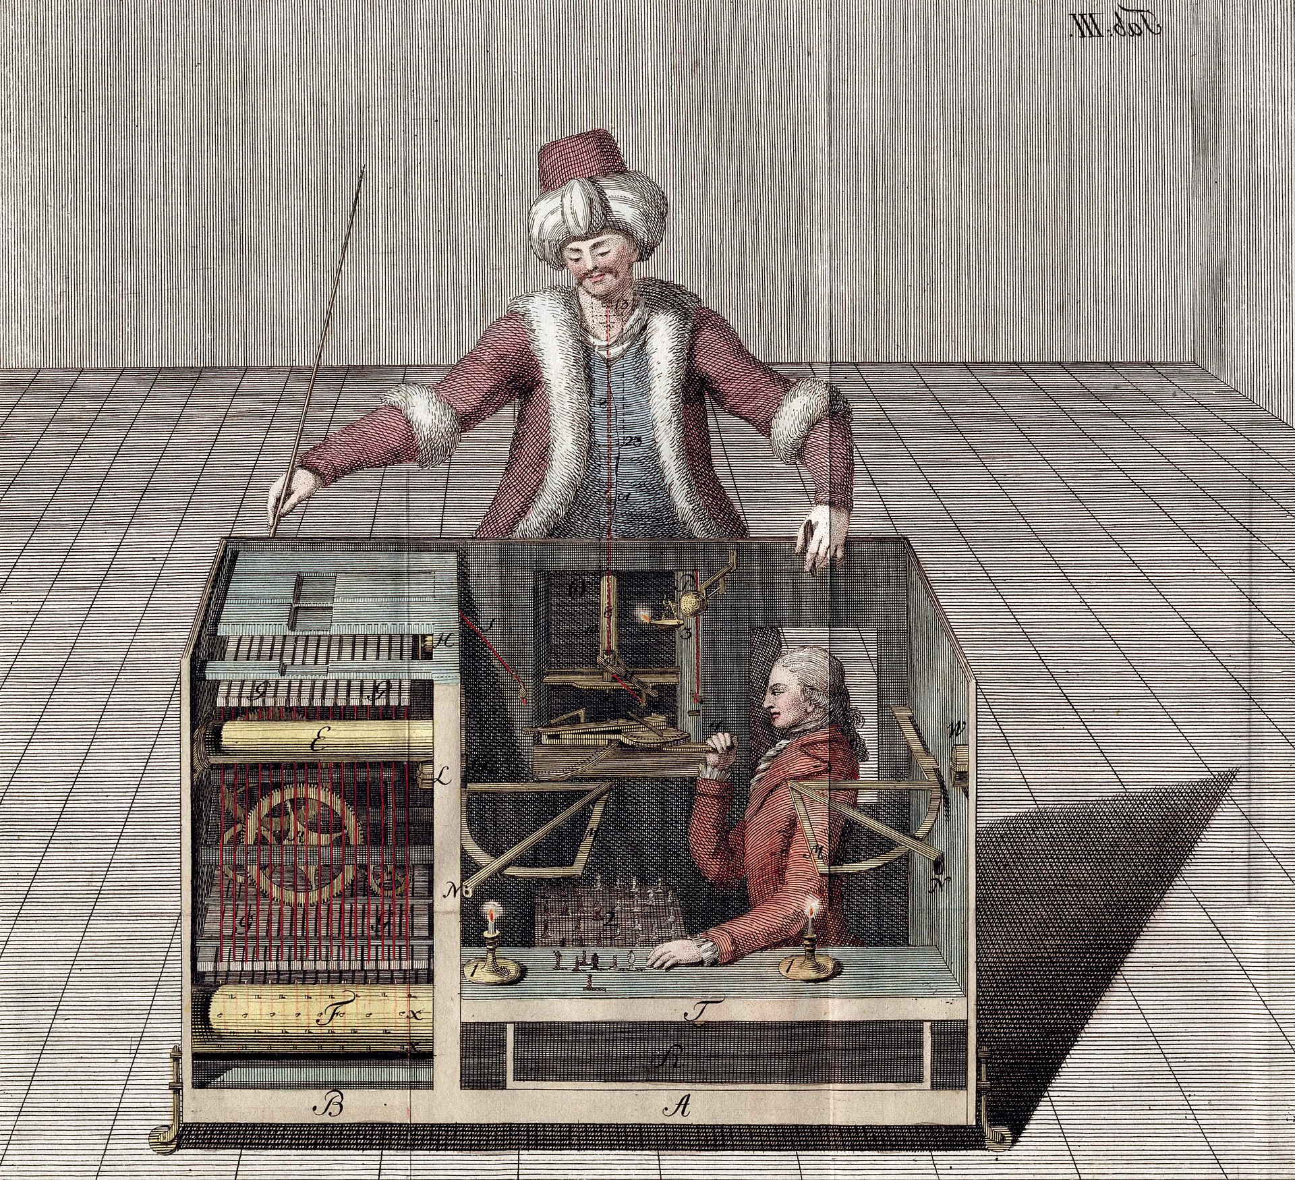

Slide 17
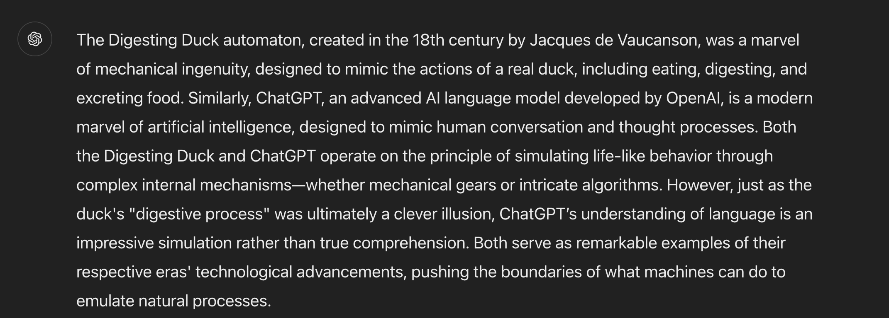
AI: An illusion?
Answer by ChatGPT

Slide 18
The first vending machine

Slide 19
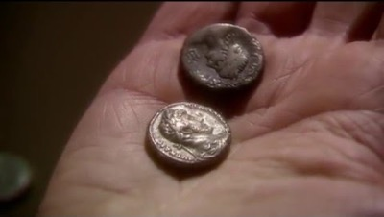
The first vending machine

Slide 20

Any sufficiently advanced technology is indistinguishable from magic

Slide 21
AI: Magic?
Magic is done by magicians
Magicians (AI scientists and big-tech) can get in a position of privilege and abuse
Understanding AI and opening the black-box is important
Common people also need to understand what is AI

Slide 22
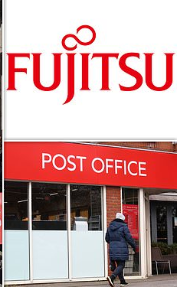
Should not substitute people with AI
Fujitsu scandal
Prosecutions and Convictions: Based on the evidence provided by the faulty Horizon IT system, the Post Office prosecuted around 736 postmasters for theft, fraud, and false accounting. Many of these individuals were convicted, with some even serving prison sentences.
For years, postmasters insisted that they had not committed any crimes and that the discrepancies were due to issues with the Horizon system.
However, their concerns were dismissed by the Post Office, which relied on the Horizon system's data to assert their guilt.
Takeaway: Decisions should be made by people, not machines

Slide 23
Big tech in AI: boon or curse?
Big tech
Creates jobs
Too much power getting concentrated in the hands of a few companies
We do not want a repeat of the East India company

Slide 24
Future Directions
Explainable AI
Human AI collaboration

Slide 25
My journey and personal experiences

Slide 26
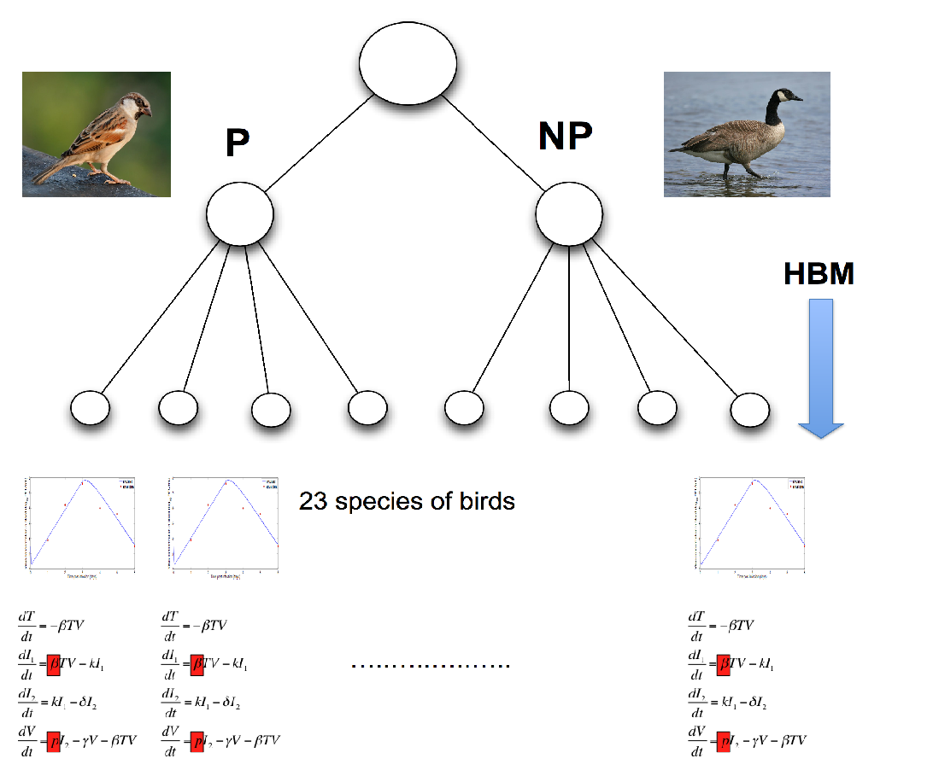
Hierarchical Bayesian models of infection
J. Roy. Soc. Interface, 2017 (Royal Society publishing group), Impact factor = 4.5

Slide 27

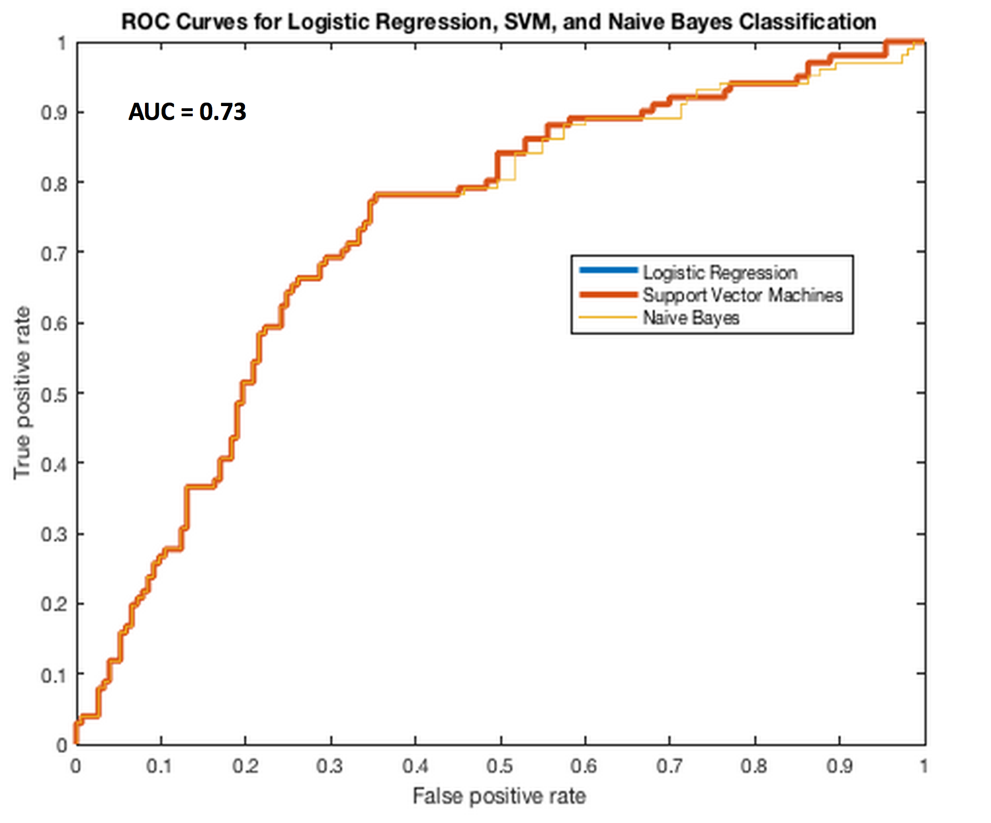

Clinical Informatics for Serious Illnesses
Clinical genomic data
Machine Learning
Stratify patients
Anonymization and security procedures
Clinical metadata
Input from domain experts (clinicians, statisticians, patients)

Slide 28
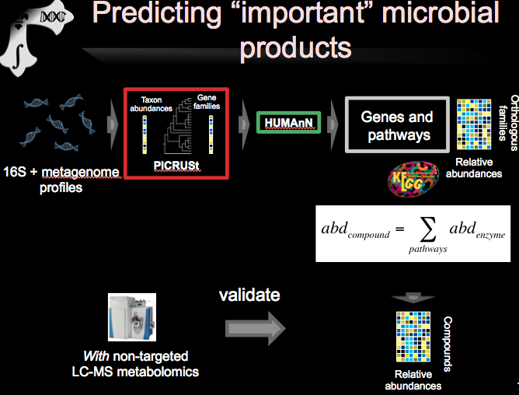
Nature Communications, 2019 (Nature publishing group), Impact factor = 14.9

Slide 29

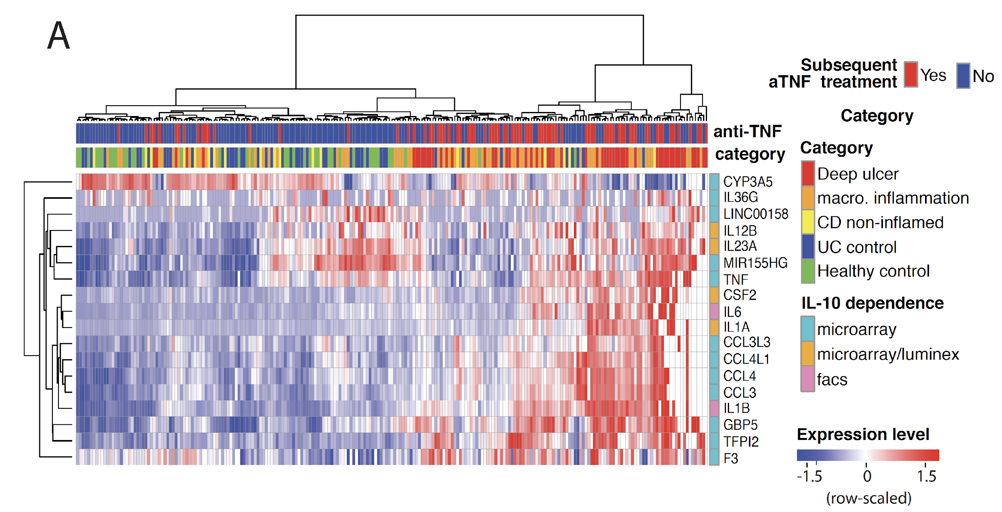

Using machine learning algorithms to predict disease
Gut, 2020 (British Medical Journal publishing group), Impact factor = 19

Slide 30
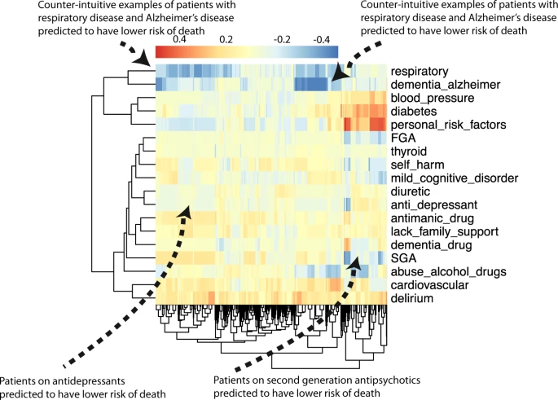
Interpretable machine learning
NPJ Schizophrenia, 2021 (Nature Partner Journal), Impact factor 6.6

Slide 31
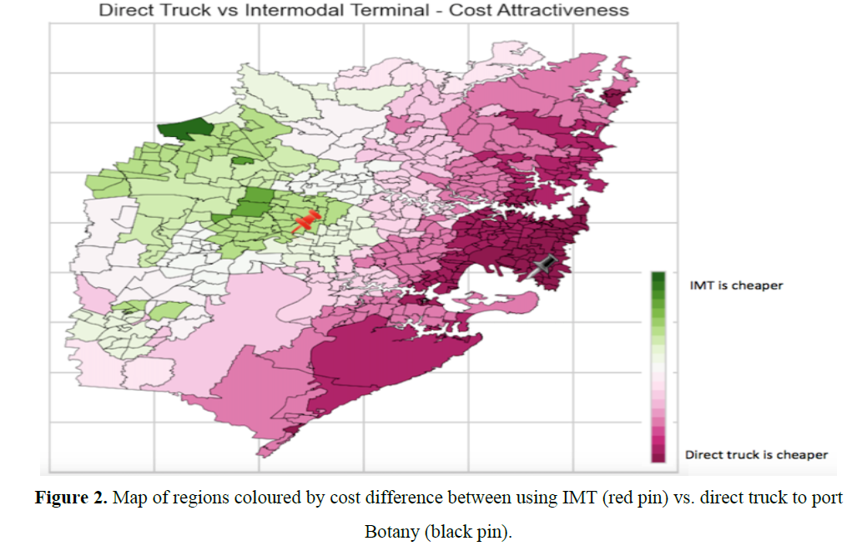
Using machine learning in supply chains
Notes:
simulators

Slide 32
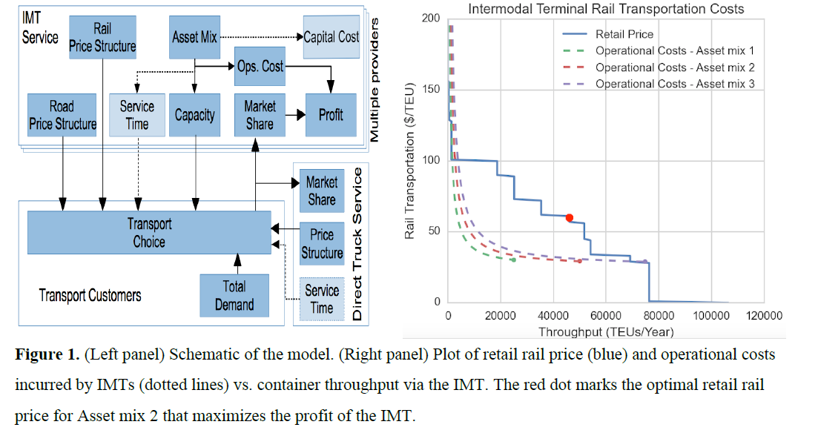
Using machine learning in supply chains
Notes:
forecasting and simulators linked to commercial data from companies

Slide 33
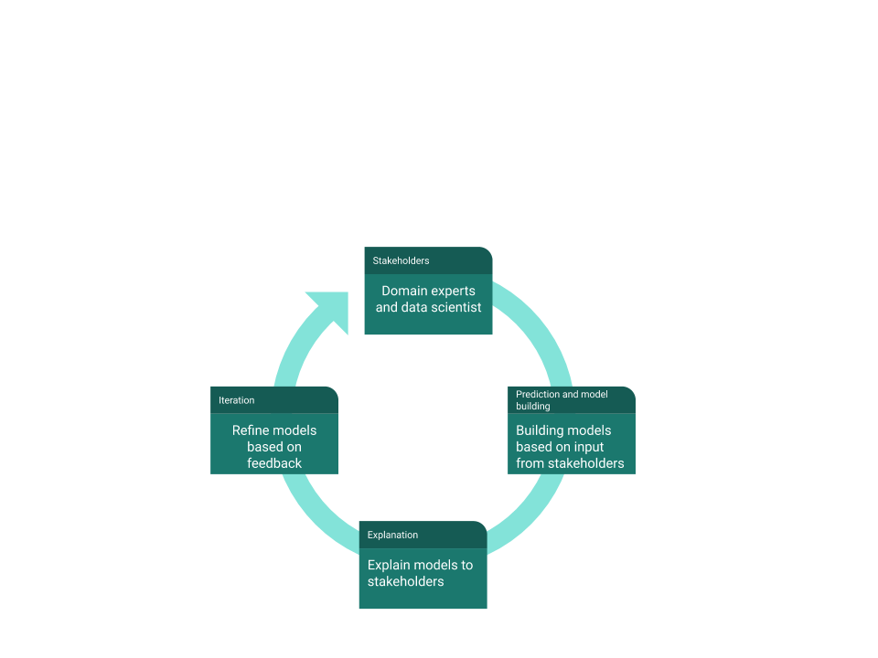
Research and teaching philosophy

Slide 34
Advice
Power of curiosity
Collaborate and work in teams
Focus on basic concepts not buzzwords

Slide 35
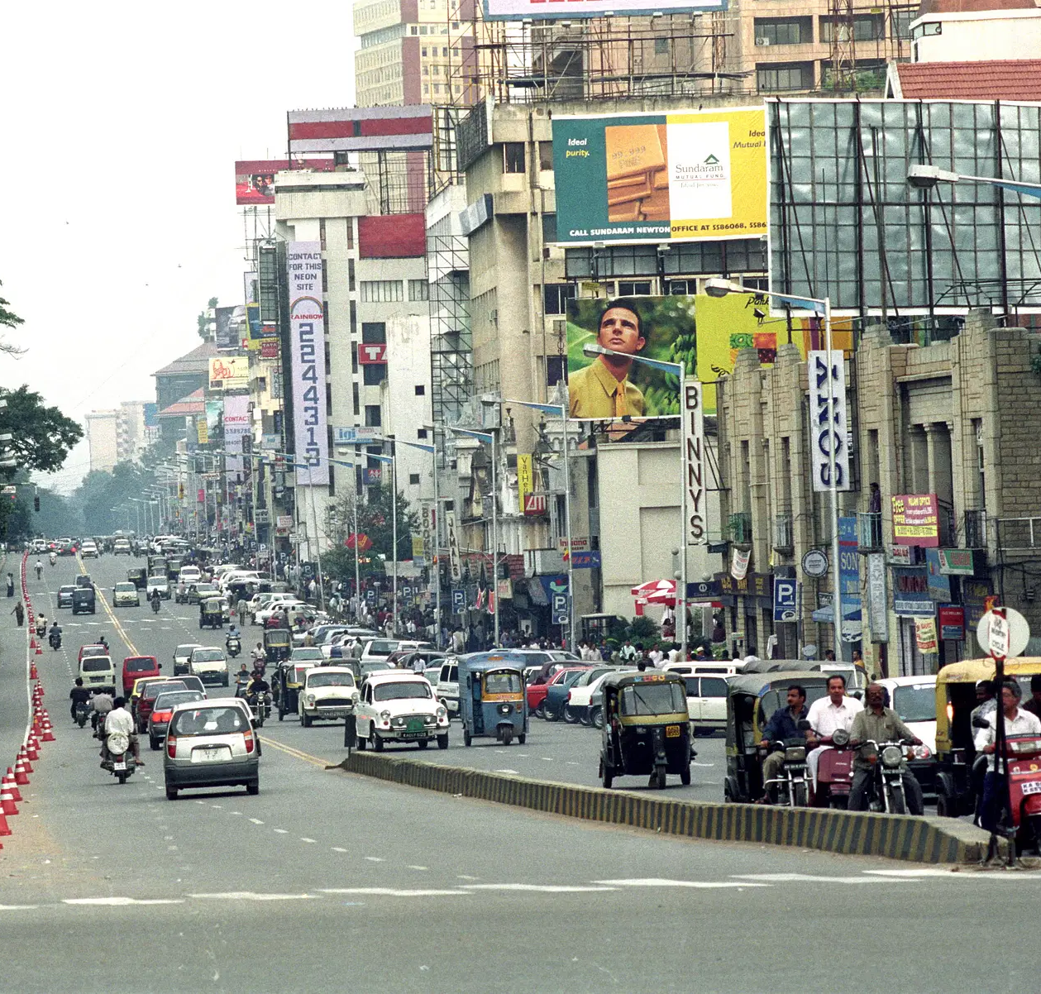
Impact of AI on India
1990s IT boom in India

Slide 36

Closing Message
Work with humans
AI: Artificial Intelligence
Not Artificial Insanity or Artificial Stupidity
Focus on basic concepts

Slide 37
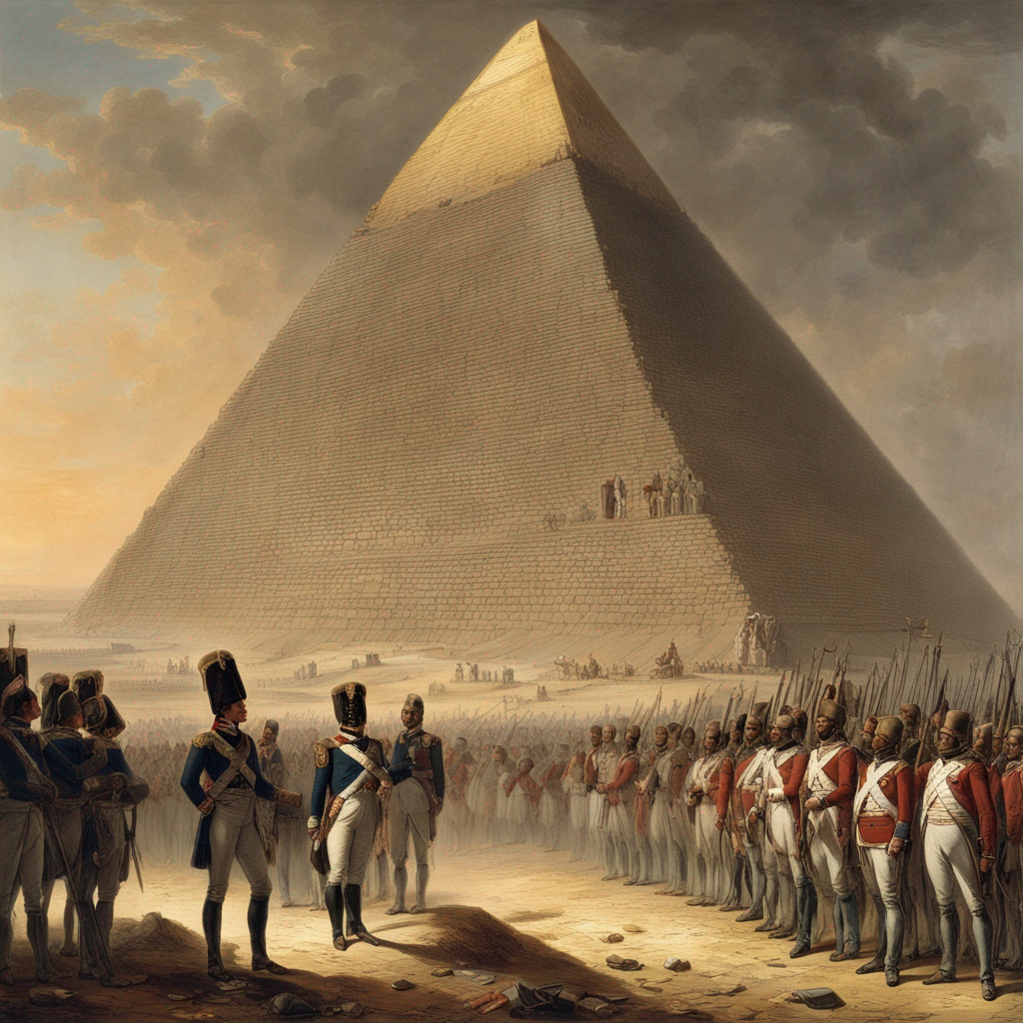
40 centuries look down upon you ….
Created using DreamUp AI
Notes:
Entrepreneurial spirit
Atmanirbhar Bharat, IndiaAI mission and 2047 goals

